Slide 1
Salem & Witchcraft
First Year Seminar
Salem: Place, Myth, and Memory
Miguel Peguero

Slide 2
The Witch Trials of 1692
The Salem Witch Trials began Spring of 1692. A group of young girls in Salem Village claimed to be possessed by the devil and accused a few local women of witchcraft.
Once a wave of hysteria spread, a special court was created to hear the cases, called Court of Oyer and Terminer.
Amid waning public support of the witch trials, the then current Governor Phips dissolved the Court and another was formed called The Superior Court of Judicature.
The Superior Court of Judicature would disregard Spectral Evidence, released those awaiting trials and pardoned the ones awaiting execution.
Trials continued but dwindled down until early 1693.

Slide 3
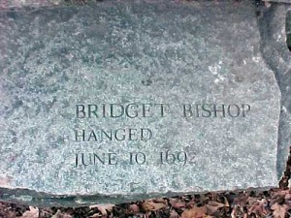
Bridget Bishop
First person accused and executed due to witchcraft in June, 1692.
“In Salem folklore, she is portrayed as a feisty, fun-loving, lusty, innkeeper who can't seem to keep herself out of trouble. Recently, historians have painted a somewhat different picture, owing to the confusion with Sarah Bishop who also appears in the court records of the witch trials.”
Picture Credit: http://historyofmassachusetts.org/bridget-bishop-witch-or-easy-target/

Slide 4
Tried & Executed
Bridget Bishop
George Burroughs
Martha Carrier
Martha Corey
Mary Easty
Sarah Good
Elizabeth Howe
George Jacobs, Sr.
Sarah Wildes
John Willard
Susannah Martin
Rebecca Nurse
Alice Parker
Mary Parker
John Proctor
Ann Pudeator
Wilmott Red
Margaret Scott
Samuel Wardwell

Slide 5
Witchcraft Today
It mostly understood that witchcraft is a pantheistic religion that includes reverence for nature, belief in the rights of others and pride in one’s own spirituality.
Practitioners of witchcraft focus on the good and positive in life and in the spirit and entirely reject any connection with the devil.
Their beliefs go back to ancient times, long before the advent of Christianity, so no ties exist between them and the Christian belief of evil.
Witchcraft has been and is confused with a belief of a pointy black hat, green face and a broomstick.

Slide 6
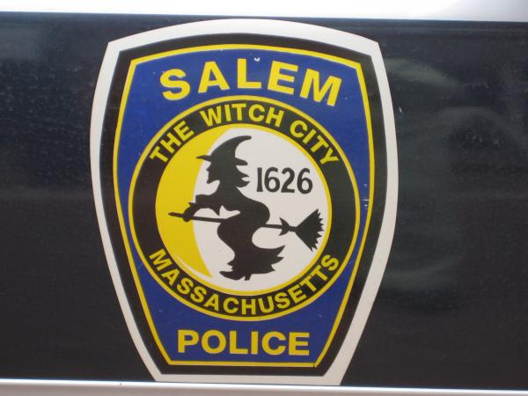
Salem “Witch City”
Today Salem is globally known as “Witch City,” witches have been commercialized to drive money into the city.
The image of a witch on a broomstick is on everything, cups, t-shirts, posters, people even get tattoos of witches.
The emblem for the police department in Salem is a witch on a stick
People came to Salem for witch merchandise while the city attempted to deter from that history, “The new Essex Street walkway, meant to encourage strolling shoppers to buy a wide variety of goods, became a long outdoor state for Wiccans and hucksters. The shops sold little but Witch City T-shirts, Witch City ice cream, and witchcraft souvenirs.”

Slide 7
Works Cited
"Bridget Bishop." Salem Witch Trials Notable Persons. Benjamin Ray, 1 Jan. 2002. Web. 10 Dec. 2014.
Linder, Douglas O. "The Salem Witchcraft Trials of 1692." The Salem Witchcraft Trials of 1692. 1 Sept. 2009. Web. 10 Dec. 2014.
Morrison, Dane Anthony, and Nancy Lusignan Schultz. "Salem as Witch City." Salem: Place, Myth, and Memory. Boston: Northeastern UP, 2005. 348. Print.

