Slide 1
WICCA
The history, explanation, and current issues of it all
Danielle Jenkins

Slide 2
History
Wicca is mainly a 20th century idea of ancient nature worship systems based out of northern Europe that existed thousands of years ago.
These pagan oriented nature worship systems were practiced for years on end but were mainly practiced in secret (and still are today). The secrecy was especially necessary during the European dominance of the Roman Catholic Church.
Unlike other religions, Wicca mainly focuses on the woman. Since woman brings life into the world. Males do not dominate this religion unlike many religion and cultures.

Slide 3
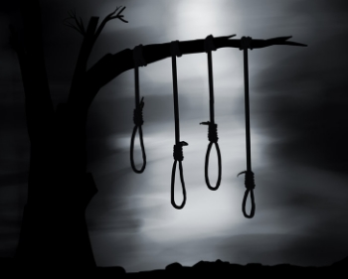
Wicca In Salem’s Past
The Salem Witch trials began in the spring of 1692.
Several young girls in the village claimed to be processed by the devil due to several of the locals doing witchcraft.
Since this time, the court had cleared the name of the accused
It is known that all of the accused were falsely accused and not witches
Currently, Wicca does take place in Salem on a daily basis

Slide 4
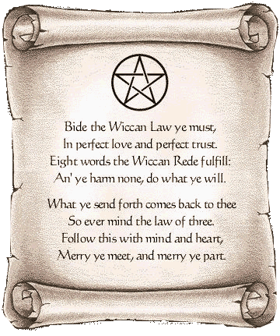
What Exactly is Wicca?
Ideas and Principles
“Wicca has no high authority, no single leader, no prophet and no Bible to dictate its laws and beliefs”. – George Knowles
Christians have 10 commandments… Wicca's have 13 Principles http://www.religioustolerance.org/wic_beli.htm
Main focuses are male and female are equal.
Receive energy and appreciate environment
They do not want their religion oppressed (especially by conservative Christians)
Wicca is usually practices solitarily, but sometimes they form groups also known as Covens
Wiccans do not believe in the devil
VIDEO → https://www.youtube.com/watch?v=EwDz8HOOg58

Slide 5
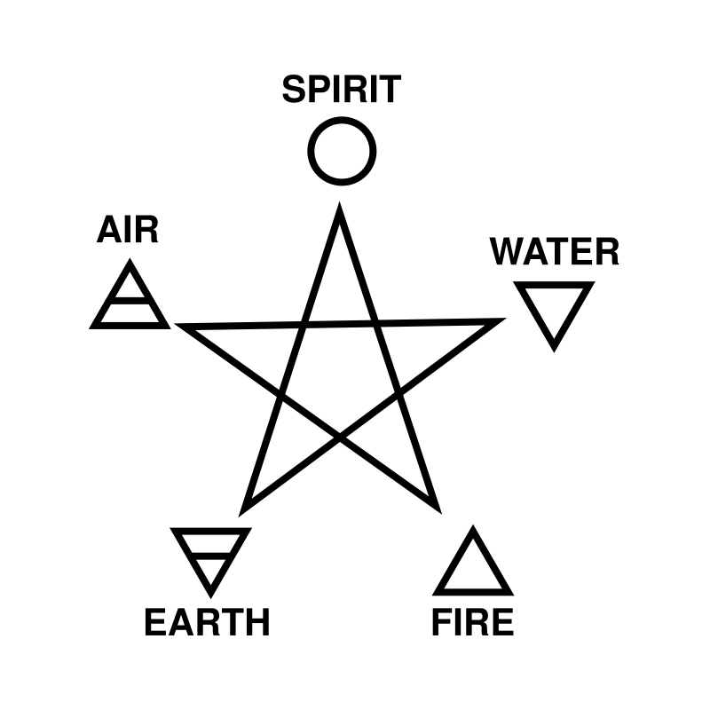
Religious Symbol
Wicca’s religious symbol is the pentagon
Four of the five points represent the elements of nature (air. Earth, fire, and water
The top point represent the spirit
The pentagon is meant to represent a balance between oneself and nature

Slide 6
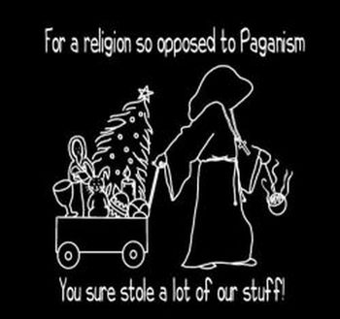
Confrontations with Wiccans
Christians continuously attack the Wicca religions due to lack of understanding
Common Misconceptions are:
Wiccans worship the devil
Wiccan’s freely curse people
The pentacle is an evil
“I've noticed that the most vociferous attackers of Paganism online are Christians. I don't have anything against the Christian faith, but the simple truth is, it's not people of the Jewish faith quoting off-topic passages of the Torah on our message boards, it's not atheists telling us to turn away from our "evil ways," and it's not Hindus who spam our websites en masse by proselytizing.” –Jo

Slide 7
Sources
https://carm.org/religious-movements/wicca/history-and-origins-wicca
http://www.history.com/topics/salem-witch-trials
http://www.religioustolerance.org/wic_beli.htm
http://modernalchemyst.hubpages.com/hub/The-10-Most-Annoying-Things-Christians-Say-to-Pagans-Witches-Wiccans

